Slide 1


Slide 2

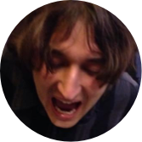

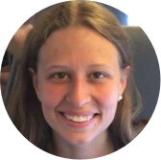


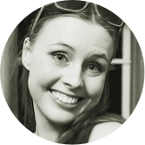

Machine Translation
http://www.inf.ed.ac.uk/teaching/courses/mt/
Teaching team:
Sameer Bansal
Nikolay Bogoychev
Anna Currey
Soňa Galovičová
Sorcha Gilroy
Jonathan Mallinson
Ida Szubert
Clara Vania

Slide 3
虽然 北 风 呼啸 , 但 天空 依然 十分 清澈 。
However , the sky remained clear under the strong north wind .
Notes:
This is the problem we’re trying to solve.
-Exercise for language learners: draw lines between the related words. This is an alignment.
-First thing is obvious: the words move around.
-Non-literal translation.
-non word-to-word translation.
-unaligned words.
-Multiple possible translations.
very hard domain, why not use machine learning?

Slide 4
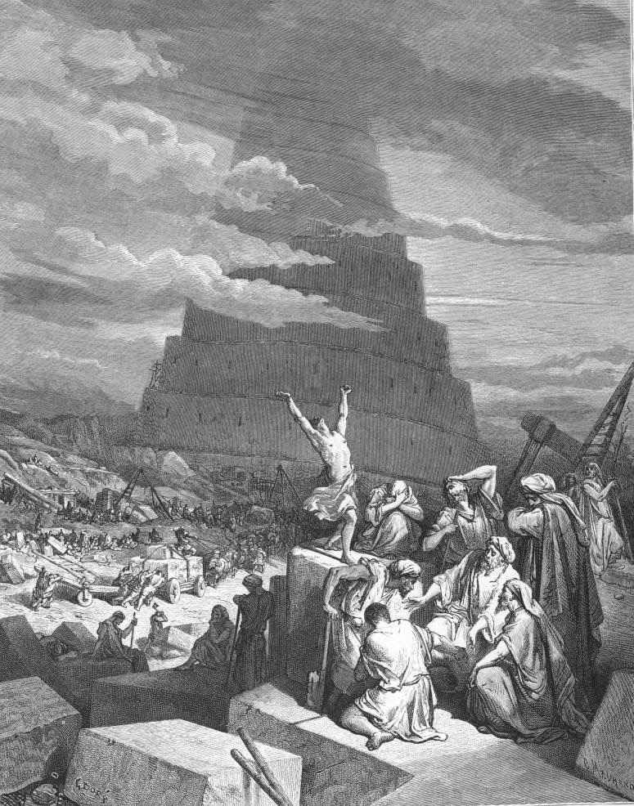
The Confusion of Tongues
Gustave Doré (1865)
Notes:
Translation is an old problem -- talked about in books written thousands of years ago.
There are a whole lot of well-known systems for solving it, with varying degrees of failure.

Slide 5
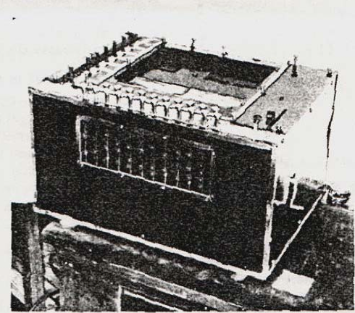
Georges Artsrouni’s “mechanical brain”, patented 1933 (France)
Notes:
In his 1933 description, he stated explicitly that his ‘brain’ could be adapted for the “translation of
a foreign language into one of the three other languages recorded in it”, and that even
if “the existing model could operate only on these four languages… the number of
languages and the number of words contained in the dictionary for each language
could be without limit.”

Slide 6
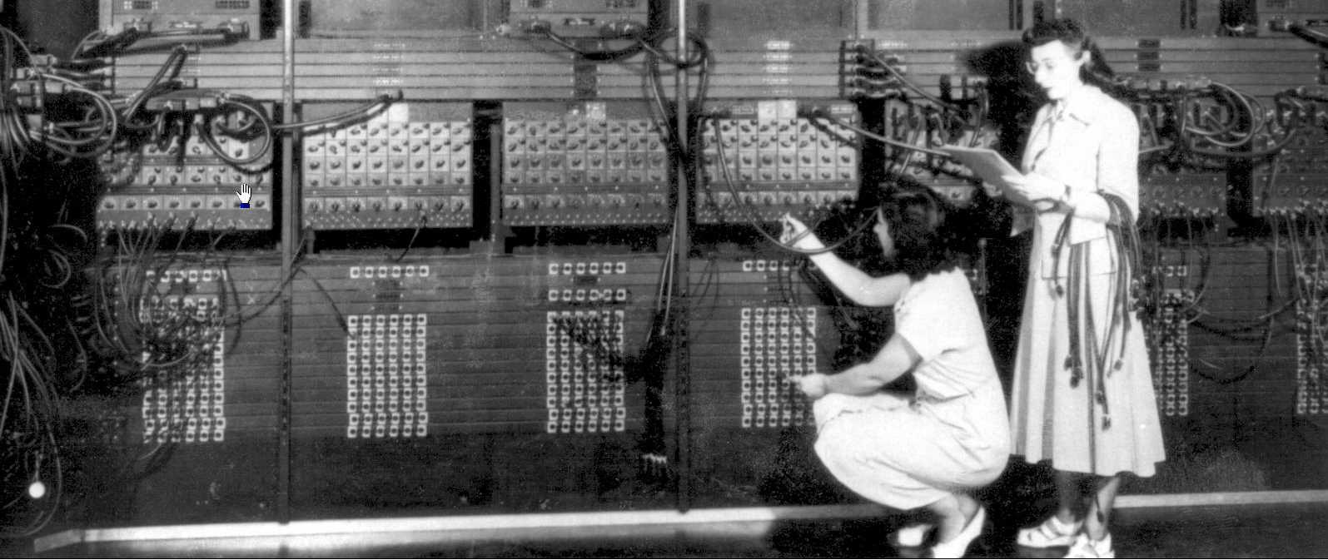
ENIAC (1946), first computer
Gloria Ruth Gordon and Ester Gerson, first programmers

Slide 7
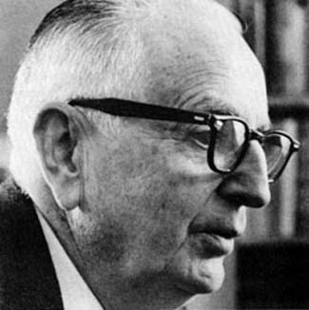
When I look at an article in Russian, I say: “This is really written in English, but it has been coded in some strange symbols. I will now proceed to decode.”
Warren Weaver (1949)

Slide 8
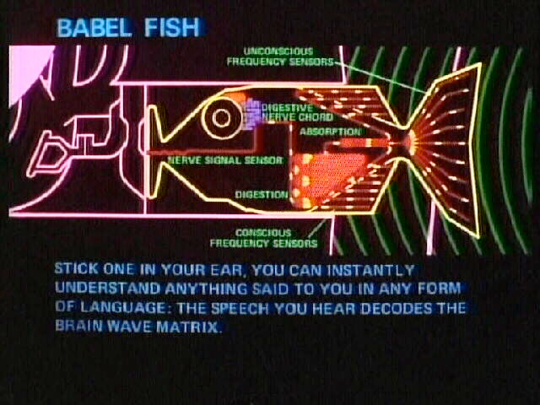
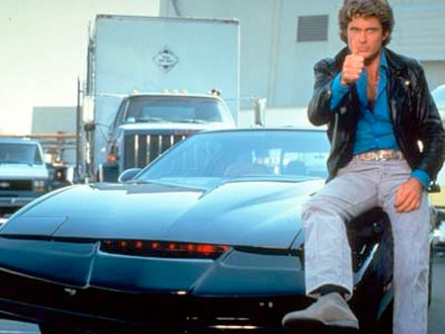
Popular view of MT in 2005
Popular view of NLP:

Slide 9



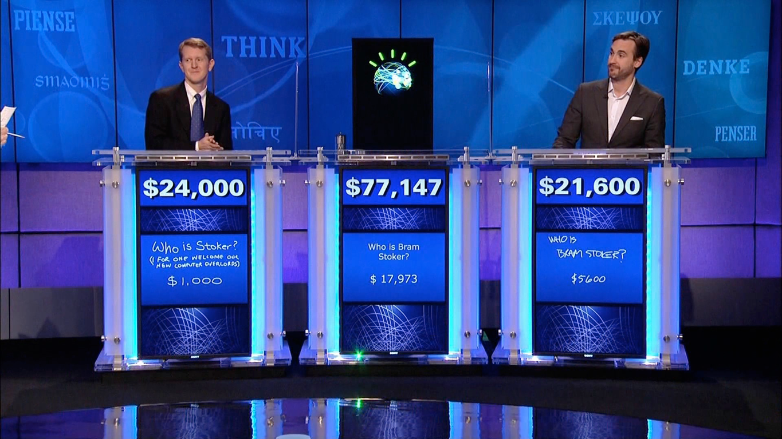

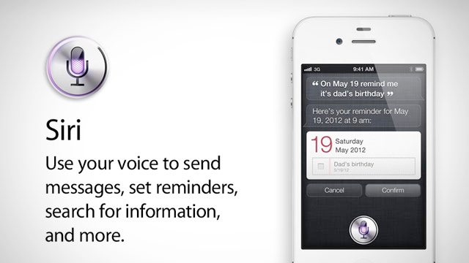
Popular view of MT in 2017
and NLP:

Slide 10
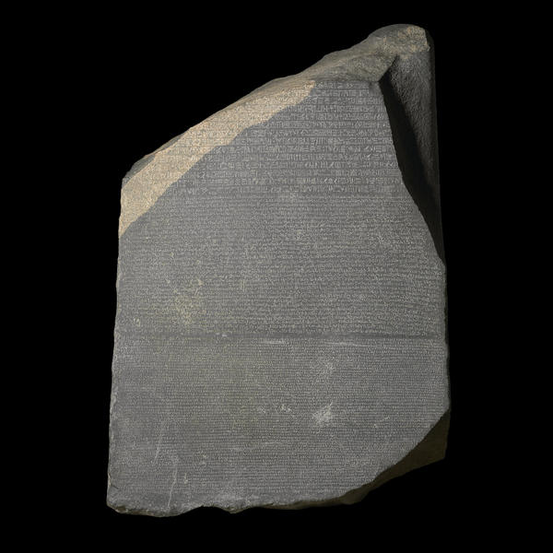
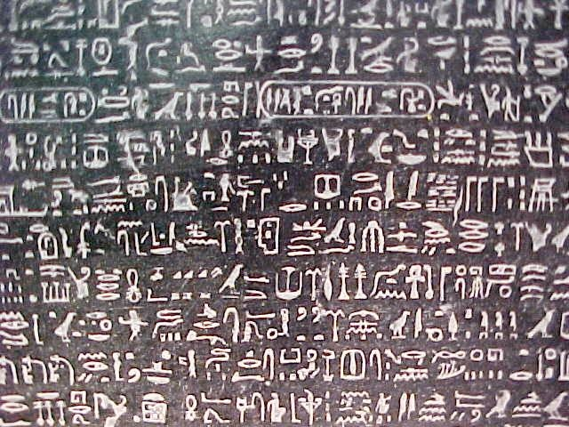
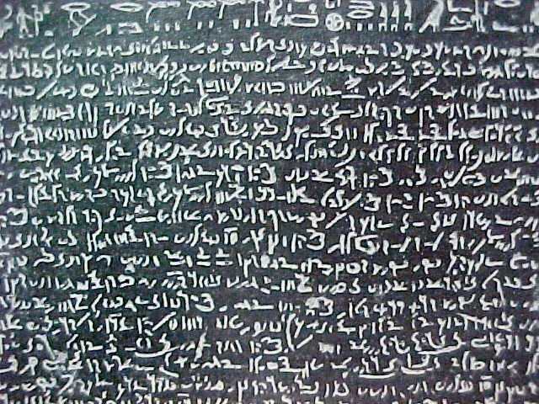
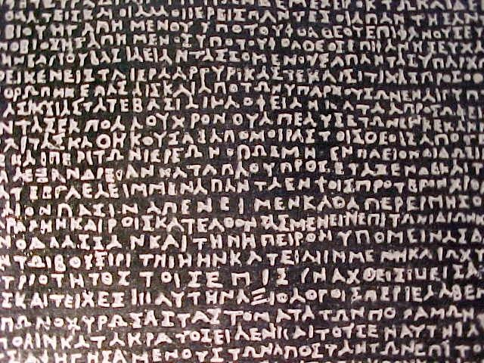
Notes:
When you’re doing general research in MT, you’re required to show this image in all talks... it’s in the contract you sign when you get the free toaster.
We solve translation the same way that Jean-François Champollion solved it.

Slide 11
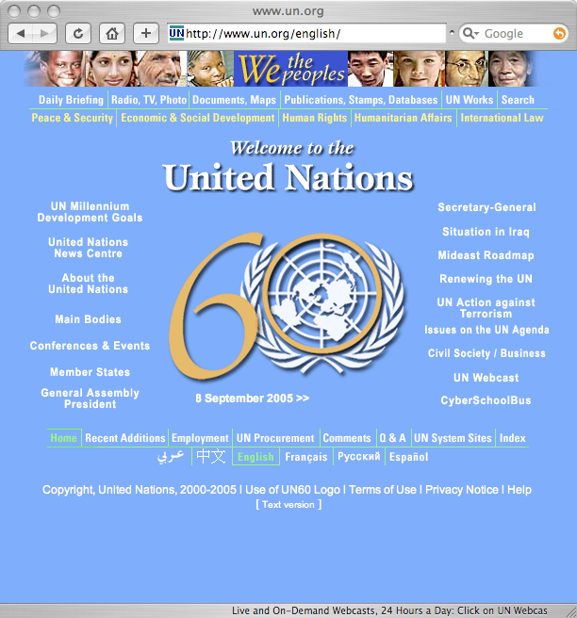


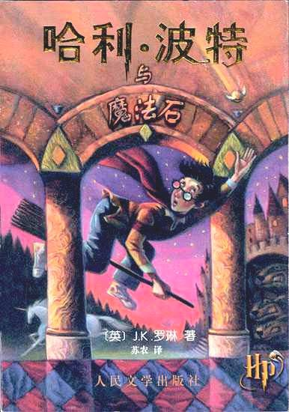
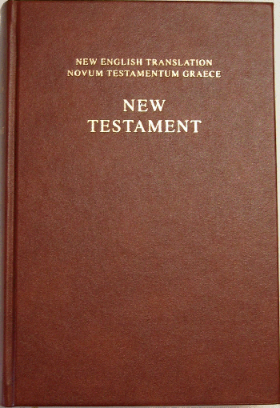
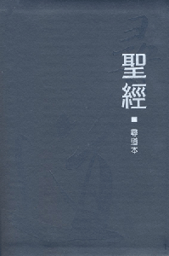

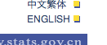


Notes:
How do we use all of this data?
One way to do it is to write rules. In the old rule-based systems, you have a test, and you keep writing new rules until the tests pass.
This obviously doesn’t scale.
Idea: learn everything from the data, i.e. machine learning.
To do this, we need something called a model.

Slide 12
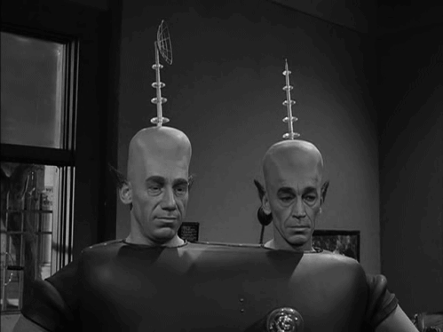
Translation Exercise

Slide 13
iat lat pippat eneat hilat oloat at-yurp .
ok-voon ororok sprok .
at-voon bichat dat .
ok-drubel ok-voon anok plok sprok .
at-drubel at-voon pippat rrat dat .
erok sprok izok hihok ghirok .
totat dat arrat vat hilat .
ok-voon anok drok brok jok .
at-voon krat pippat sat lat .
wiwok farok izok stok .
totat jjat quat cat .
lalok sprok izok jok stok .
wat dat krat quat cat .
lalok farok ororok lalok sprok izok enemok .
wat jjat bichat wat dat vat eneat .
lalok brok anok plok nok .
iat lat pippat rrat nnat .
wiwok nok izok kantok ok-yurp .
totat nnat quat oloat at-yurp .
lalok mok nok yorok ghirok clok .
wat nnat gat mat bat hilat .
lalok nok crrrok hihok yorok zanzanok .
wat nnat arrat mat zanzanat .
lalok rarok nok izok hihok mok .
wat nnat forat arrat vat gat .
Notes:
-Sentences have the same number of words, except for 11.

Slide 14
iat lat pippat eneat hilat oloat at-yurp .
ok-voon ororok sprok .
at-voon bichat dat .
ok-drubel ok-voon anok plok sprok .
at-drubel at-voon pippat rrat dat .
erok sprok izok hihok ghirok .
totat dat arrat vat hilat .
ok-voon anok drok brok jok .
at-voon krat pippat sat lat .
wiwok farok izok stok .
totat jjat quat cat .
lalok sprok izok jok stok .
wat dat krat quat cat .
lalok farok ororok lalok sprok izok enemok .
wat jjat bichat wat dat vat eneat .
lalok brok anok plok nok .
iat lat pippat rrat nnat .
wiwok nok izok kantok ok-yurp .
totat nnat quat oloat at-yurp .
lalok mok nok yorok ghirok clok .
wat nnat gat mat bat hilat .
lalok nok crrrok hihok yorok zanzanok .
wat nnat arrat mat zanzanat .
lalok rarok nok izok hihok mok .
wat nnat forat arrat vat gat .
Notes:
-Sentences have the same number of words, except for 11.

Slide 15
iat lat pippat eneat hilat oloat at-yurp .
arrat : hihok
at-drubel : ok-drubel
at-voon : ok-voon
at-yurp : ok-yurp
bat : clok
bichat : ororok
cat : stok
dat : sprok
eneat : enemok
forat : rarok
pippat : anok
quat : izok
rrat : plok
sat : drok
totat : erok
totat : wiwok
vat : izok
wat : lalok
zanzanat : zanzanok
??? : crrrok
gat : mok
hilat : ghirok
iat : lalok
jjat : farok
krat : jok
lat : brok
mat : yorok
nnat : nok
oloat : kantok

Slide 16
iat lat pippat eneat hilat oloat at-yurp .
arrat : hihok
at-drubel : ok-drubel
at-voon : ok-voon
at-yurp : ok-yurp
bat : clok
bichat : ororok
cat : stok
dat : sprok
eneat : enemok
forat : rarok
pippat : anok
quat : izok
rrat : plok
sat : drok
totat : erok
totat : wiwok
vat : izok
wat : lalok
zanzanat : zanzanok
??? : crrrok
gat : mok
hilat : ghirok
iat : lalok
jjat : farok
krat : jok
lat : brok
mat : yorok
nnat : nok
oloat : kantok

Slide 17
iat lat pippat eneat hilat oloat at-yurp .
lalok brok anok enemok ghirok kantok ok-yurp .
arrat : hihok
at-drubel : ok-drubel
at-voon : ok-voon
at-yurp : ok-yurp
bat : clok
bichat : ororok
cat : stok
dat : sprok
eneat : enemok
forat : rarok
pippat : anok
quat : izok
rrat : plok
sat : drok
totat : erok
totat : wiwok
vat : izok
wat : lalok
zanzanat : zanzanok
??? : crrrok
gat : mok
hilat : ghirok
iat : lalok
jjat : farok
krat : jok
lat : brok
mat : yorok
nnat : nok
oloat : kantok

Slide 18
iat lat pippat eneat hilat oloat at-yurp .
lalok brok anok enemok ghirok kantok ok-yurp .
ok-voon ororok sprok .
at-voon bichat dat .
ok-drubel ok-voon anok plok sprok .
at-drubel at-voon pippat rrat dat .
erok sprok izok hihok ghirok .
totat dat arrat vat hilat .
ok-voon anok drok brok jok .
at-voon krat pippat sat lat .
wiwok farok izok stok .
totat jjat quat cat .
lalok sprok izok jok stok .
wat dat krat quat cat .
lalok farok ororok lalok sprok izok enemok .
wat jjat bichat wat dat vat eneat .
lalok brok anok plok nok .
iat lat pippat rrat nnat .
wiwok nok izok kantok ok-yurp .
totat nnat quat oloat at-yurp .
lalok mok nok yorok ghirok clok .
wat nnat gat mat bat hilat .
lalok nok crrrok hihok yorok zanzanok .
wat nnat arrat mat zanzanat .
lalok rarok nok izok hihok mok .
wat nnat forat arrat vat gat .
Notes:
-Sentences have the same number of words, except for 11.

Slide 19
iat lat pippat eneat hilat oloat at-yurp .
lalok anok brok enemok kantok ghirok ok-yurp .
ok-voon ororok sprok .
at-voon bichat dat .
ok-drubel ok-voon anok plok sprok .
at-drubel at-voon pippat rrat dat .
erok sprok izok hihok ghirok .
totat dat arrat vat hilat .
ok-voon anok drok brok jok .
at-voon krat pippat sat lat .
wiwok farok izok stok .
totat jjat quat cat .
lalok sprok izok jok stok .
wat dat krat quat cat .
lalok farok ororok lalok sprok izok enemok .
wat jjat bichat wat dat vat eneat .
lalok brok anok plok nok .
iat lat pippat rrat nnat .
wiwok nok izok kantok ok-yurp .
totat nnat quat oloat at-yurp .
lalok mok nok yorok ghirok clok .
wat nnat gat mat bat hilat .
lalok nok crrrok hihok yorok zanzanok .
wat nnat arrat mat zanzanat .
lalok rarok nok izok hihok mok .
wat nnat forat arrat vat gat .
Notes:
-Sentences have the same number of words, except for 11.

Slide 20
iat lat pippat eneat hilat oloat at-yurp .
lalok brok anok kantok ghirok enemok ok-yurp .
ok-voon ororok sprok .
at-voon bichat dat .
ok-drubel ok-voon anok plok sprok .
at-drubel at-voon pippat rrat dat .
erok sprok izok hihok ghirok .
totat dat arrat vat hilat .
ok-voon anok drok brok jok .
at-voon krat pippat sat lat .
wiwok farok izok stok .
totat jjat quat cat .
lalok sprok izok jok stok .
wat dat krat quat cat .
lalok farok ororok lalok sprok izok enemok .
wat jjat bichat wat dat vat eneat .
lalok brok anok plok nok .
iat lat pippat rrat nnat .
wiwok nok izok kantok ok-yurp .
totat nnat quat oloat at-yurp .
lalok mok nok yorok ghirok clok .
wat nnat gat mat bat hilat .
lalok nok crrrok hihok yorok zanzanok .
wat nnat arrat mat zanzanat .
lalok rarok nok izok hihok mok .
wat nnat forat arrat vat gat .
5040 possible orderings!
Notes:
-Sentences have the same number of words, except for 11.

Slide 21
iat lat pippat eneat hilat oloat at-yurp .
lalok brok anok enemok ghirok kantok ok-yurp .
ok-drubel anok ghirok farok .
wiwok rarok nok zerok ghirok enemok .
ok-drubel ziplok stok vok erok enemok kantok ok-yurp zinok jok yorok clok .
lalok clok izok vok ok-drubel .
ok-voon ororok sprok .
ok-drubel ok-voon anok plok sprok .
erok sprok izok hihok ghirok .
ok-voon anok drok brok jok .
wiwok farok izok stok .
lalok sprok izok jok stok .
lalok brok anok plok nok .
lalok farok ororok lalok sprok izok enemok .
wiwok nok izok kantok ok-yurp .
lalok mok nok yorok ghirok clok .
lalok nok crrrok hihok yorok zanzanok .
lalok rarok nok izok hihok mok .
Notes:
-Sentences have the same number of words, except for 11.

Slide 22
iat lat pippat eneat hilat oloat at-yurp .
lalok brok anok ghirok enemok kantok ok-yurp .
ok-drubel anok ghirok farok .
wiwok rarok nok zerok ghirok enemok .
ok-drubel ziplok stok vok erok enemok kantok ok-yurp zinok jok yorok clok .
lalok clok izok vok ok-drubel .
ok-voon ororok sprok .
ok-drubel ok-voon anok plok sprok .
erok sprok izok hihok ghirok .
ok-voon anok drok brok jok .
wiwok farok izok stok .
lalok sprok izok jok stok .
lalok brok anok plok nok .
lalok farok ororok lalok sprok izok enemok .
wiwok nok izok kantok ok-yurp .
lalok mok nok yorok ghirok clok .
lalok nok crrrok hihok yorok zanzanok .
lalok rarok nok izok hihok mok .
Notes:
-Sentences have the same number of words, except for 11.

Slide 23
totat nnat forat arrat mat bat .
erok|wiwok nok rarok hihok yorok clok .
arrat : hihok
at-drubel : ok-drubel
at-voon : ok-voon
at-yurp : ok-yurp
bat : clok
bichat : ororok
cat : stok
dat : sprok
eneat : enemok
forat : rarok
pippat : anok
quat : izok
rrat : plok
sat : drok
totat : erok
totat : wiwok
vat : izok
wat : lalok
zanzanat : zanzanok
??? : crrrok
gat : mok
hilat : ghirok
iat : lalok
jjat : farok
krat : jok
lat : brok
mat : yorok
nnat : nok
oloat : kantok
Notes:
-Sentences have the same number of words, except for 11.

Slide 24
totat nnat forat arrat mat bat .
erok|wiwok nok rarok hihok yorok clok .
ok-drubel anok ghirok farok .
wiwok rarok nok zerok ghirok enemok .
ok-drubel ziplok stok vok erok enemok kantok ok-yurp zinok jok yorok clok .
lalok clok izok vok ok-drubel .
ok-voon ororok sprok .
ok-drubel ok-voon anok plok sprok .
erok sprok izok hihok ghirok .
ok-voon anok drok brok jok .
wiwok farok izok stok .
lalok sprok izok jok stok .
lalok brok anok plok nok .
lalok farok ororok lalok sprok izok enemok .
wiwok nok izok kantok ok-yurp .
lalok mok nok yorok ghirok clok .
lalok nok crrrok hihok yorok zanzanok .
lalok rarok nok izok hihok mok .
Notes:
-Sentences have the same number of words, except for 11.

Slide 25
totat nnat forat arrat mat bat .
erok|wiwok rarok nok hihok yorok clok .
ok-drubel anok ghirok farok .
wiwok rarok nok zerok ghirok enemok .
ok-drubel ziplok stok vok erok enemok kantok ok-yurp zinok jok yorok clok .
lalok clok izok vok ok-drubel .
ok-voon ororok sprok .
ok-drubel ok-voon anok plok sprok .
erok sprok izok hihok ghirok .
ok-voon anok drok brok jok .
wiwok farok izok stok .
lalok sprok izok jok stok .
lalok brok anok plok nok .
lalok farok ororok lalok sprok izok enemok .
wiwok nok izok kantok ok-yurp .
lalok mok nok yorok ghirok clok .
lalok nok crrrok hihok yorok zanzanok .
lalok rarok nok izok hihok mok .
Notes:
-Sentences have the same number of words, except for 11.

Slide 26
totat nnat forat arrat mat bat .
wiwok rarok nok crrrok hihok yorok clok .
ok-drubel anok ghirok farok .
wiwok rarok nok zerok ghirok enemok .
ok-drubel ziplok stok vok erok enemok kantok ok-yurp zinok jok yorok clok .
lalok clok izok vok ok-drubel .
ok-voon ororok sprok .
ok-drubel ok-voon anok plok sprok .
erok sprok izok hihok ghirok .
ok-voon anok drok brok jok .
wiwok farok izok stok .
lalok sprok izok jok stok .
lalok brok anok plok nok .
lalok farok ororok lalok sprok izok enemok .
wiwok nok izok kantok ok-yurp .
lalok mok nok yorok ghirok clok .
lalok nok crrrok hihok yorok zanzanok .
lalok rarok nok izok hihok mok .
Notes:
-Sentences have the same number of words, except for 11.

Slide 27
Is this exercise realistic?
In real natural language...

Slide 28
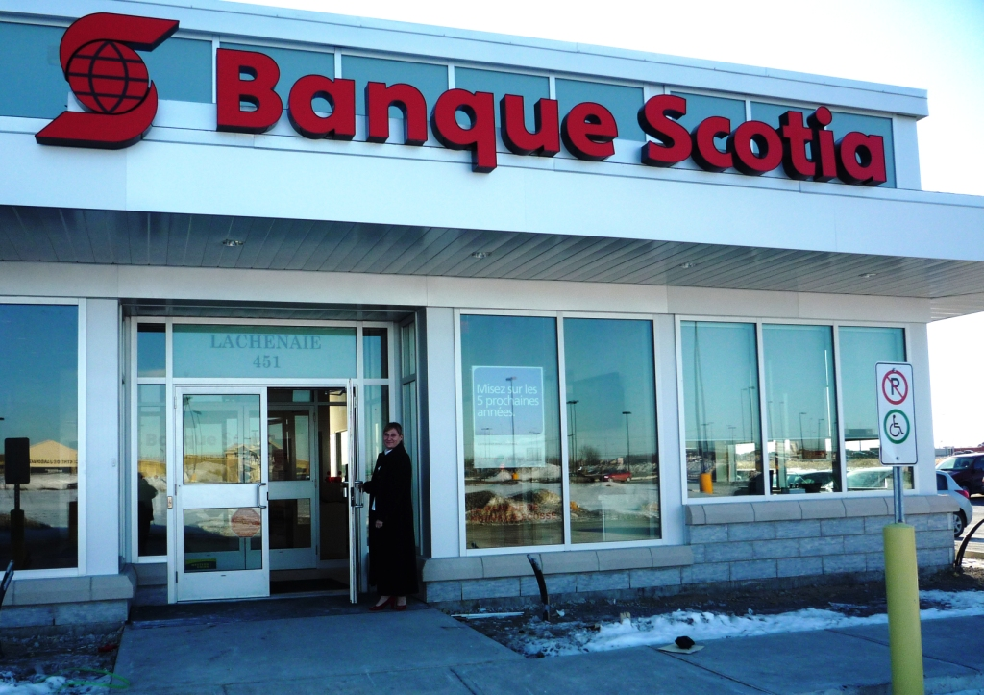
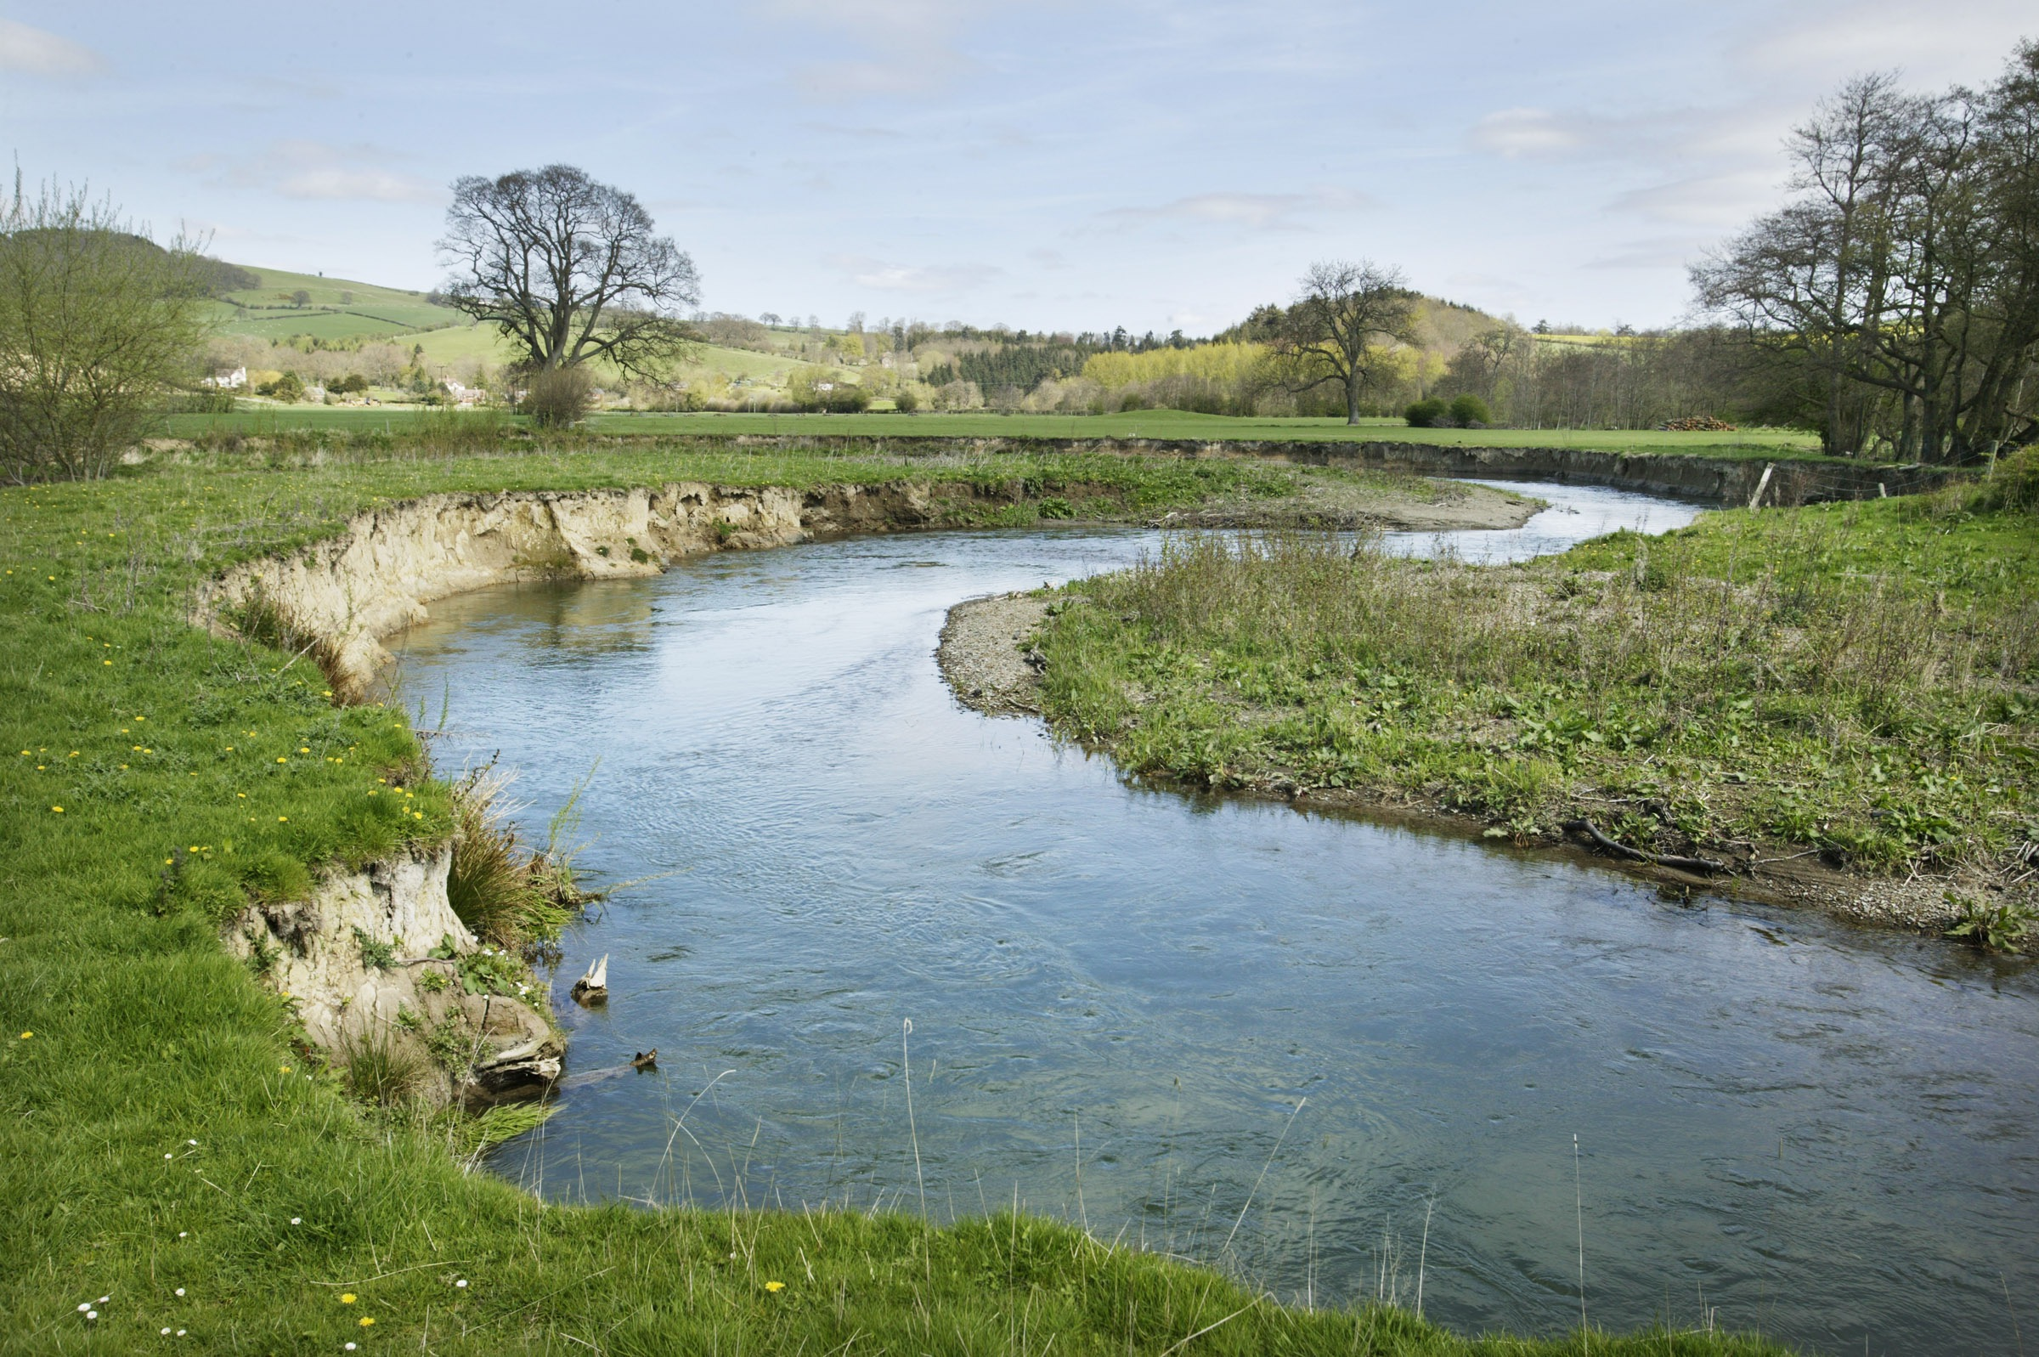
Is this exercise realistic?
In real natural language...
…words are ambiguous
English: bank
French: banque
French: rive

Slide 29
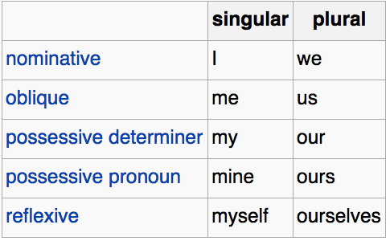
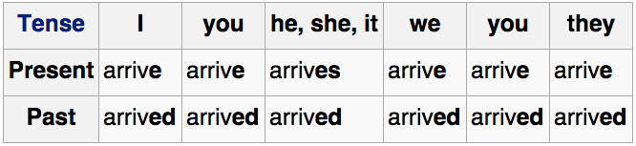
Is this exercise realistic?
In real natural language...
…words have complex morphology

Slide 30
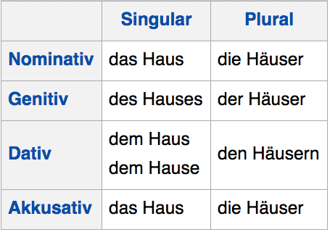
Is this exercise realistic?
In real natural language...
…words have complex morphology
… fanden sie sie auf den Stufen unseres Hauses sitzend …
… they found her sitting on the steps of our house …

Slide 31
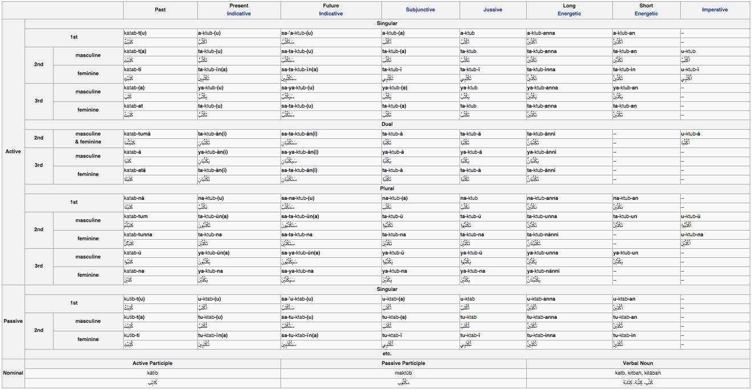
Is this exercise realistic?
forms of kataba (‘to write’) in Arabic
…words have complex morphology

Slide 32
Is this exercise realistic?
In real natural language...
…words have complex morphology
Finnish: ostoskeskuksessa
ostos#keskus+N+Sg+Loc:in
shopping#center+N+Sg+Loc:in
English: ‘in the shopping center’

Slide 33
Is this exercise realistic?
In real natural language...
…words may have non-standard orthography
dats why pluto is pluto it can neva b a star

Slide 34
Is this exercise realistic?
In real natural language...
…word order matters
Jaime loves Casey
Casey loves Jaime

Slide 35
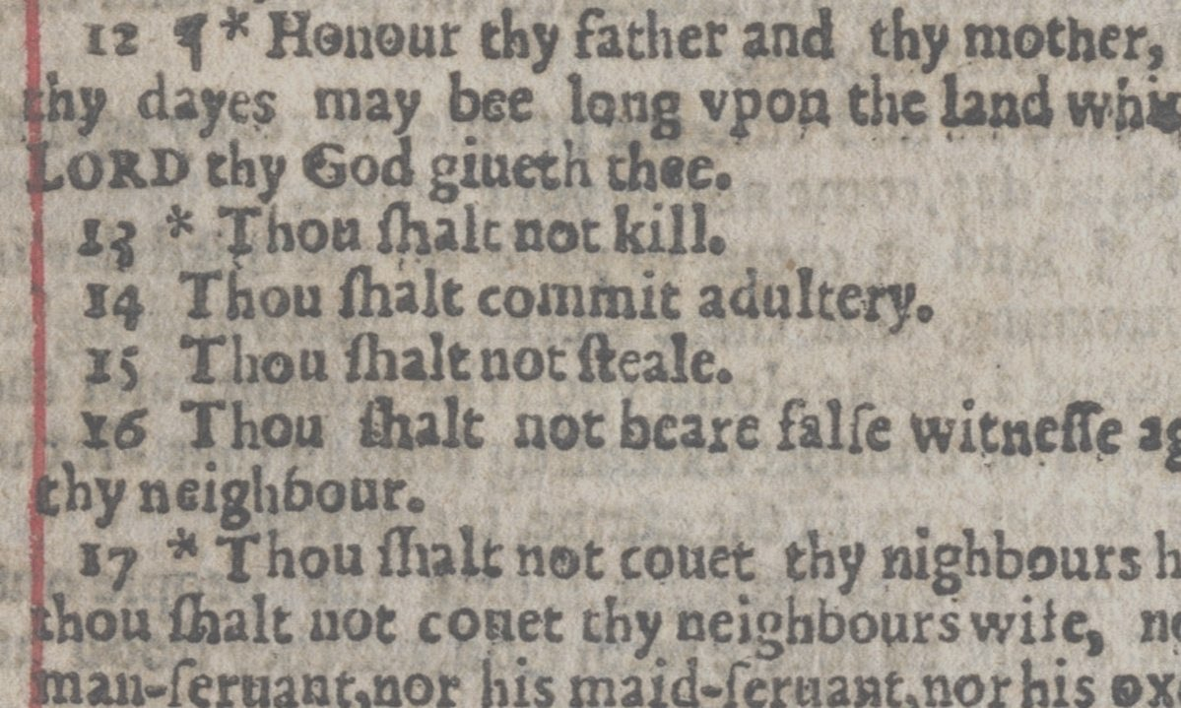
Is this exercise realistic?
In real natural language...
…every word matters

Slide 36
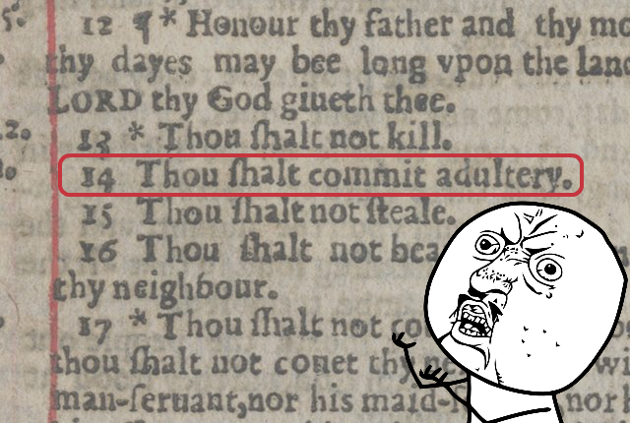
Is this exercise realistic?
In real natural language...
…every word matters

Slide 37
Is this exercise realistic?
In real natural language...
…sentences are longer.
One of Scotland’s leading cultural heritage groups will stage the Mary, Queen of Scots Festival, which is hoped to become a major new attraction for the area, which has lost the T in the Park music festival this summer after 18 years.

Slide 38
Is this exercise realistic?

Slide 39
iat lat pippat eneat hilat oloat at-yurp .
lalok brok anok ghirok enemok kantok ok-yurp .
ok-voon ororok sprok .
at-voon bichat dat .
ok-drubel ok-voon anok plok sprok .
at-drubel at-voon pippat rrat dat .
erok sprok izok hihok ghirok .
totat dat arrat vat hilat .
ok-voon anok drok brok jok .
at-voon krat pippat sat lat .
wiwok farok izok stok .
totat jjat quat cat .
lalok sprok izok jok stok .
wat dat krat quat cat .
lalok farok ororok lalok sprok izok enemok .
wat jjat bichat wat dat vat eneat .
lalok brok anok plok nok .
iat lat pippat rrat nnat .
wiwok nok izok kantok ok-yurp .
totat nnat quat oloat at-yurp .
lalok mok nok yorok ghirok clok .
wat nnat gat mat bat hilat .
lalok nok crrrok hihok yorok zanzanok .
wat nnat arrat mat zanzanat .
lalok rarok nok izok hihok mok .
wat nnat forat arrat vat gat .
Notes:
-Sentences have the same number of words, except for 11.

Slide 40
la empresa tiene enemigos fuertes en Europa .
the company has strong enemies in Europe .
Garcia and associates .
Garcia y asociados .
Carlos Garcia has three associates .
Carlos Garcia tiene tres asociados .
his associates are not strong .
sus asociados no son fuertes .
Garcia has a company also .
Garcia tambien tiene una empresa .
its clients are angry .
sus clientes estan enfadados .
the associates are also angry .
los asociados tambien estan enfadados .
the clients and the associates are enemies .
los clientes y los asociados son enemigos .
the company has three groups .
la empresa tiene tres grupos .
its groups are in Europe .
sus grupos estan en Europa .
the modern groups sell strong pharmaceuticals .
los grupos modernos venden medicinas fuertes .
the groups do not sell zanzanine .
los grupos no venden zanzanina .
the small groups are not modern .
los grupos pequenos no son modernos .

Slide 41
Questions
How do we formalize machine translation as a machine learning problem?
When does it work, and when doesn’t it? Why?
If it works, how well does it work?
How can we use it?

Slide 42
Machine Translation
http://www.inf.ed.ac.uk/teaching/courses/mt/
Teaching team:
Sameer Bansal
Nikolay Bogoychev
Anna Currey
Soňa Galovičová
Sorcha Gilroy
Jonathan Mallinson
Ida Szubert
Clara Vania

Slide 43
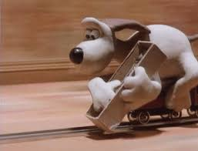
Teaching team tasks
The field has substantially changed in the last year.
So, the course must change, too.
In particular, there will be more deep learning.
But deep learning for language is probabilistic!
So our focus is probabilistic models of language.

Slide 44
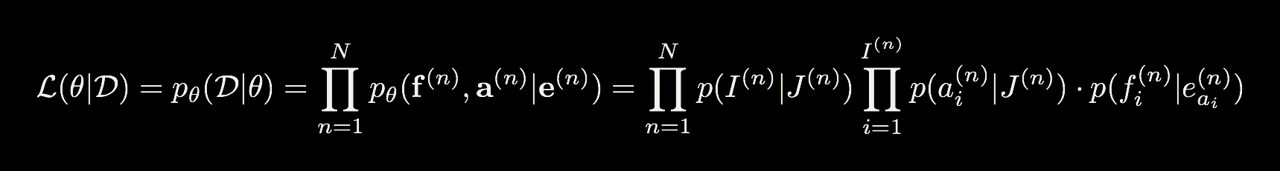
“Probabilistic models of language”
This course is about implementing…
for ej, logprob, fi, fj in alignments[ei]:
if bitmap(range(fi,fj)) & v == 0:
new_v = bitmap(range(fi,fj)) | v
if new_v in chart[ej]:
chart[ej][new_v] = logadd10(chart[ej][new_v], sums[v]+logprob)
else:
chart[ej][new_v] = sums[v]+logprob
…probabilistic models…
…of language
Ngaragana-nguja grog-PROP.IV.ACC
ngiy-a 3.SG.NM.A-PST
gujinganjanga-ni morther.II.ERG
jiyawu give
ngabulu milk.IV.ACC
`(His) mother gave (him) milk with grog in it.’ [wmb]

Slide 45
“Probabilistic models of language”
Very few people are experts in computer science, mathematics, and linguistics, and I guarantee you will encounter something you don’t know. But if you are unwilling to engage with all of these topics,
DO NOT TAKE THIS COURSE

Slide 46
“Probabilistic models of language”
To future students: There is no way that you should take this course. The reason why is that you need to be competent in linguistics, mathematics and Python programming to do well in the coursework. The lecturer neglected to mention that he expected people to have those skills, but it was clear from the assignments. You will get no help, as there are no tutorials, there is only a forum where you can ask questions, but when a student asked for help because they did not understand the material, the lecturer was not willing to make any changes.
— 2015 course review from someone who didn’t listen to the advice on the previous slide.

Slide 47
“Probabilistic models of language”
The teaching team is willing to answer questions on piazza. You will get more out of this if you also answer questions.
If you want answers to questions you must be specific. This is not specific (nor is it a question):
Need more help
I would like to write on behalf of a group of people who are finding this assignment impossible.

Slide 48
Your tasks: complete by Thursday
Sign up for piazza
Review the course syllabus
Review Basic Probability Theory (Goldwater)
Review the online video lectures (available tonight)
By Wednesday at 4pm, post any questions to piazza

